Slide 1
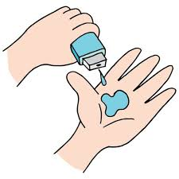
Doctor Visit Data Report
Jessica Gonsalves
Manipal Institute of Technology, Manipal

Slide 2

PROBLEM STATEMENT
The problem is to analyze how demographic factors (gender, age, income), health status (illness, reduced activities, general health), healthcare coverage (private insurance, free healthcare for the poor, free healthcare for repatriated individuals), and chronic conditions affect the number of healthcare visits individuals make. The goal is to identify the key determinants that drive healthcare visits and to provide insights that can inform targeted healthcare interventions and improve resource allocation.

Slide 3
Project Description
The dataset includes individual records on healthcare visits, demographic details (gender, age, income), health status (illness, reduced activities, general health), healthcare coverage (private insurance, free healthcare for the poor, free healthcare for repatriated individuals), and chronic conditions.
Objective: To analyze and identify key factors influencing the number of healthcare visits.
Analysis Areas:
Demographics: Correlation of gender, age, and income with healthcare visits.
Health Status: Impact of illness, reduced activities, and general health on visit frequency.
Healthcare Coverage: Role of different coverage types in determining visit frequency.
Chronic Conditions: Relationship between chronic conditions and healthcare visits
Goals:
Identify significant determinants of healthcare visits.
Provide insights for optimizing healthcare resource allocation.
Develop predictive models for healthcare visit trends.
This analysis will inform targeted healthcare interventions and improve healthcare delivery.

Slide 4

WHO ARE THE END USERS?
Healthcare Providers: Hospitals, clinics, and individual practitioners can use the insights to optimize resource allocation, improve patient care, and plan for staffing and inventory needs based on predicted visit trends.
Policy Makers: Government agencies and public health organizations can leverage the findings to create informed policies, allocate funding more effectively, and design targeted health programs for different demographic groups.
Insurance Companies: Private insurers can use the data to understand patterns in healthcare utilization, adjust premiums, and develop customized insurance plans that better meet the needs of their clients.
Healthcare Researchers: Academics and analysts can further investigate the correlations and causal relationships identified in the data, contributing to the broader body of healthcare knowledge.
Public Health Organizations: Organizations focused on public health can use the insights to identify at-risk populations, develop intervention programs, and improve access to healthcare services.

Slide 5

Technology Used
Development Environment:
Jupyter Notebook in VS Code: For interactive data analysis and visualization.
Programming Language:
Python: For scripting and implementing data analysis.
Data Analysis:
Pandas: For data manipulation and analysis.
NumPy: For numerical operations.
Data Visualization:
Matplotlib: For creating static visualizations.
Version Control:
Git: For version control and collaboration.

Slide 6
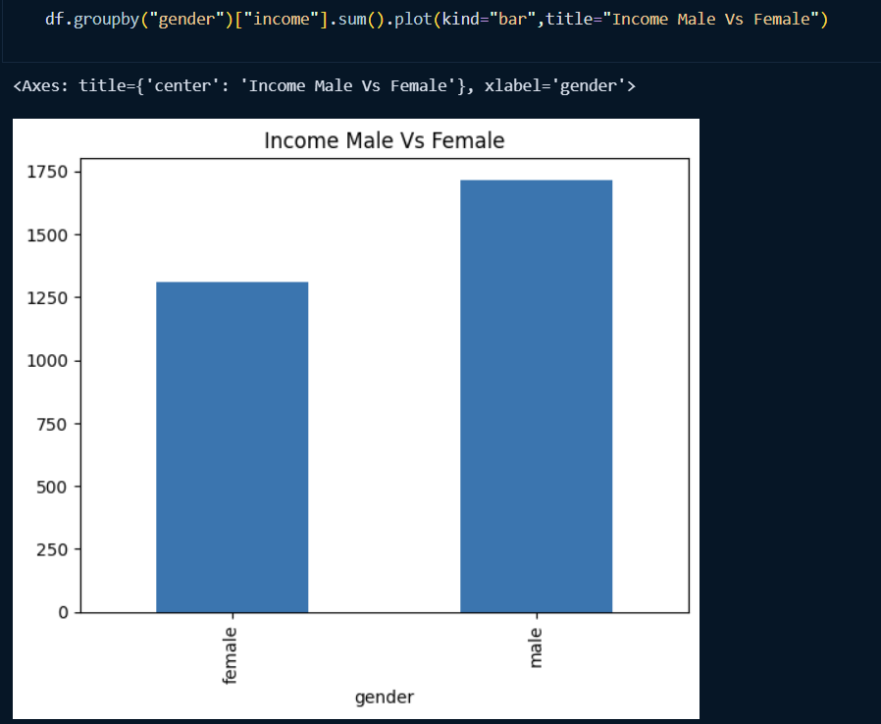
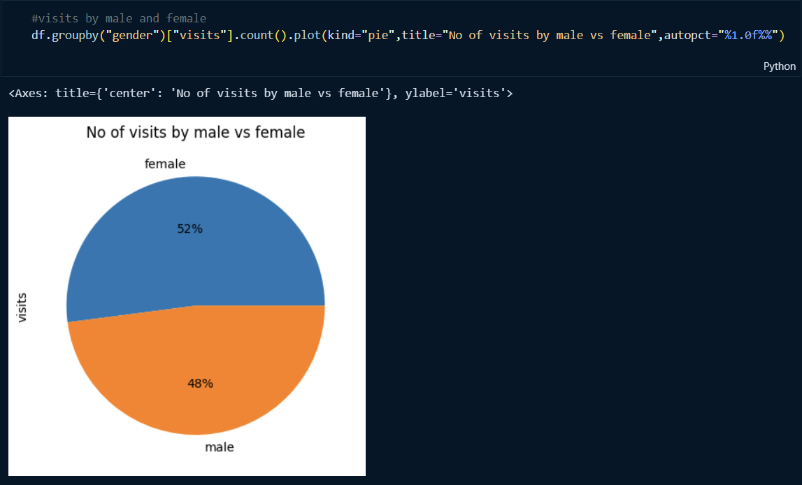
RESULTS
The remaining interpretations can be found on the Github link below
https://github.com/jessicaGonsalves04/VOIS_Internship/tree/main/DIY%201-%20Doctor%20Visit

Slide 7
Thank you
.
.

